Slide 1
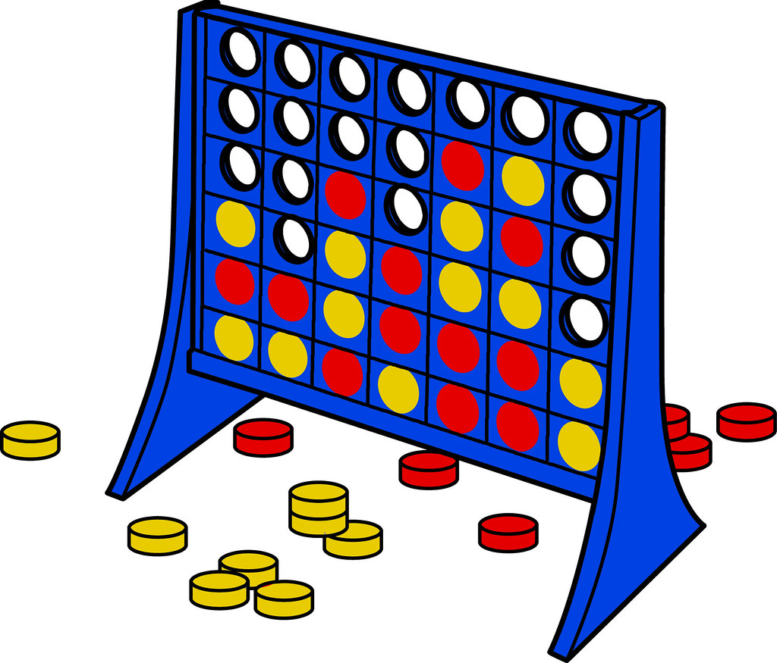
Connect 4

Slide 2
Instructions
DO NOT play in presentation mode
When it is a players turn, they drag their circle piece to the column they want to put it in. The piece should be placed in the last slot of that column or the first open slot (on top of other pieces).
If your students have remote access control, they can drag pieces on their own.
If they do not have remote access have them tell you which #column they want their piece to be placed on their turn.
Continue play between 2 players or teams of players until someone gets 4 in a row or all slots have been filled.
Video example: https://youtu.be/DsYEpoCWQaw

Slide 3
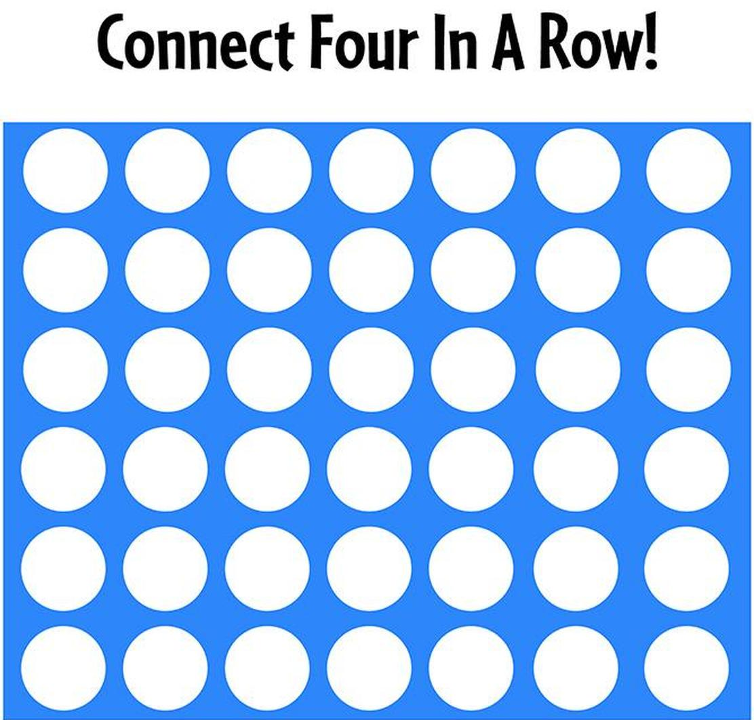
1
2
3
4
5
6
7

