Slide 1
Treasure Hunt
An adventure game!

Slide 2
How To:
Everyone works together as one team! The goal is to get to the treasure before the island explodes!
Start a timer or alarm for 5 or 10 minutes of play.
The team has to get to treasure before time runs out.
Players take turns spinning the wheel.
Click the wheel to spin.
Click again to stop when player says “stop”.
Advance the number of spaces spun forward. (i.e. if player spins a 3 click on 3 gray squares). To do this click on the gray squares.
When clicking on each gray square one of 3 things will appear:
Green squares- safe continue moving
Arrow(s)- team get to makes a decision which way to go
Booby Trap- movement stops and team must wait 10 seconds before next player spins wheel. Just count backwards from 10 out loud.

Slide 3
How To Continued:
Continue play until they get to treasure or island explodes.
If the time runs out an alarm goes off before the team gets to the treasure click the small hour glass on the bottom of the slide. This will advance to the explosion.
Play moves in direction seen below(unless there is an arrow in which team gets to pick direction). Each time you move to a new board start at first square and follow this direction.
start
Start play on Slide 4!
To next slide

Slide 4
Video Example:
https://youtu.be/tc6D-Vzhb1Y

Slide 5
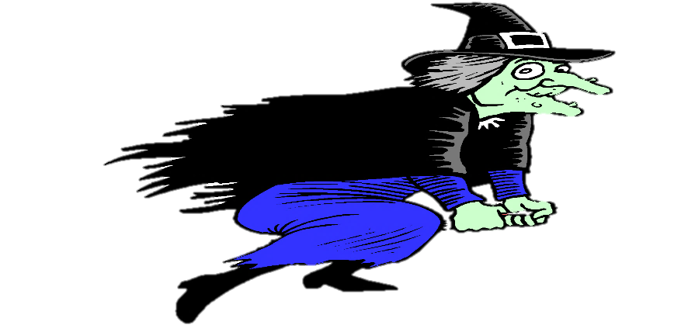
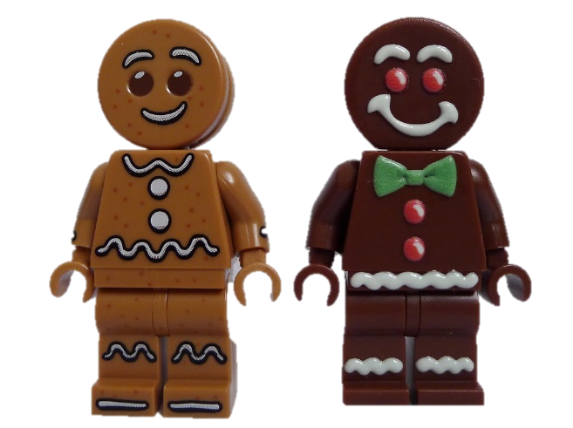
Treasure Hunt
You must help the gingerbread men find the treasure. The treasure was stolen from them years ago from the evil witch. Be careful the witch set up lots of booby traps. Can your team find the treasure before time runs out and the island explodes?
Spin the wheel and uncover the number of spaces to move.
Sometimes you have a choice which way to go.
If you land on a booby trap you have to wait 10 seconds before you can spin again.

Slide 6
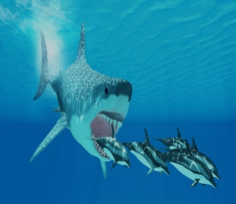
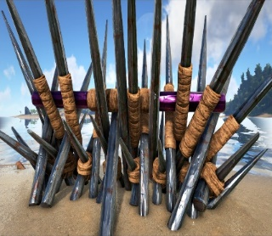
1
4
2
3

Slide 7
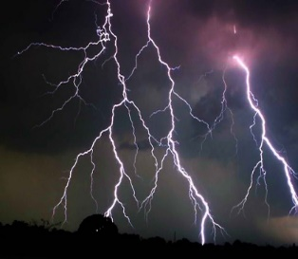
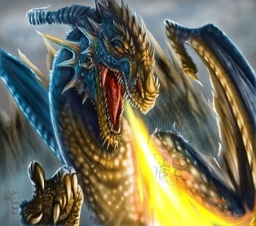
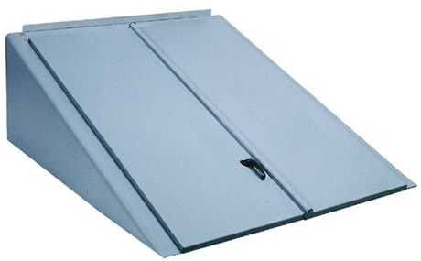
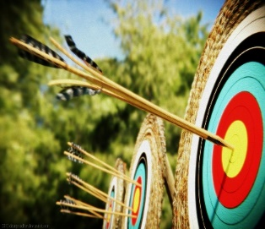
1
4
2
3
Notes:
One square reveals a door- ask if players want to open door or not. If they choose to open door click on door to reveal their “fate” (booby trap).

Slide 8
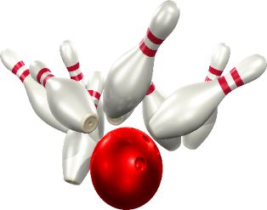
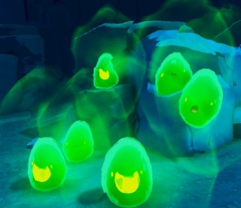
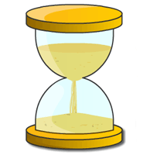
1
4
2
3

